Slide 1


HYPERLEDGER FABRIC FOR THE ENTERPRISE Privacy and Security Strategies
Talk
Grant Steinfeld¹, Matthew Cousens²
¹ Developer Advocate – Blockchain and Java, IBM ² Developer Advocate – Z & LinuxONE, IBM

Slide 2
Hyperledger Fabric discussion about Trust Security and Privacy

Slide 3

https://github.com/Grant-Steinfeld/hlf-private-data https://bit.ly/2xf0PvK
Notes:
Slides and notes at https://bit.ly/2xf0PvK

Slide 4


VECTORS OF CONCERN
INTERNAL
EXTERNAL
Notes:
Consurtium
Nature of blockchain
Privacy
External
Hackers – indication of environment/cloud/datacenter setup wrt security
Industrial Espionage, bored summer vacation

Slide 5
Security
SecOps
Platform
SRE / Security
Pen testing TLS
Notes:
Hyperledger Fabric undergoes periodic Security and License Audits whose results are publicly
A security assessment for v1.1 was published by Nettitude in September of 2017, and , and the assessment for v2.0.x is in progress.
IBM Cloud requires that all services undergo pen testing and that all endpoints use TLS. Specifically,
TLS 1.2 is enabled for all endpoints. All communication between nodes (peer to peer, peer to orderer) is secured with TLS and all communication from the UI to the nodes is also TLS
IBM Blockchain Platform will have support for HSM in 3Q.

Slide 6
Set theory – Privacy and Security
Architectural Design / Governance
Platform / DevOps
Fast Data
Applications
SECURITY
PRIVACY
Quality of design and Ethics
Platform robustness and SRE(s) skillset

Slide 7
“Nettitude is delighted to have had the opportunity to work with The Linux Foundation to assess the security of their Hyperledger Fabric blockchain software. This was an exciting and timely piece of work, in a field which Nettitude had already identified as one of our security research priorities.”
Notes:
end results of the audit showed only a couple medium grade security issues that have since been mitigated. One issue was a general lack of comments in the code that documented the expected behavior of the code. This is an important detail because programmers can look at the code and figure out what it does, but bugs lurk in the difference between what the original programmer intended and what the code actually does. Having thorough comments in the code helps reduce the risk of a security regression occurring during future software maintenance work.
The other issue was focused on the general security of the Docker container used to execute chain code. The principle of least authority dictates that the Docker container should be restricted and isolated as much as possible.

Slide 8
Set theory – Privacy and Security
Architectural Design / Governance
Platform / DevOps
Fast Data
Applications
SECURITY
PRIVACY
Utopia HLF
Quality of design and Ethics
Platform robustness and SRE(s) skillset

Slide 9
Before Blockchain Centralized Architectures
security breach of the central authority could be catastrophic, risking the financial underpinning of the market- place and possibly destroying trust in the business.

Slide 10
SmartContract - chain code
Peer pull requests review [ good ]
Continuous Integration [ bad ]

Slide 12
Flexibility choices to run Hyperledger Fabric
VMWare OpenStack
Cloud / Hybrid cloud
HARDWARE
Intel – Linux
IBM Power - Linux
IBM Z
IBM LinuxONE
IBM Cloud Private (ICP)
On premises
Security Improvement
Notes:
Because of its distributed architecture, blockchain is best suited for the hybrid cloud model and can be deployed both in the public cloud and on premises.
The decision on where to deploy block- chain could, for example, depend on if a managed service is preferred for ease of use, or whether government, industry, or corporate regulations mean that data needs to be held locally.

Slide 13
LinuxONE Security Enables Blockchain
Built-in encryption
Key management
Workload isolation
IBM Secure Service Container
Notes:
The IBM LinuxONE platform is designed to make applications
Perform faster and more efficiently
with the highest levels of security
Customized Go language

Slide 14
Not at software level!
“all the way”
END TO END
Built in Encryption
LinuxONE hardware encryption
IBM Cloud Hyper Protect Crypto Services
Integrates
IBM Key Protect
IBM Cloud data
Code in Swift Java JavaScript
Notes:
Encryption and decryption can decrease performance, and Linux- ONE has dedicated on-chip co-processors for hardware encryption and decryption of data without the typical processing overhead associated with software encryption. The low overhead of LinuxONE hardware encryption enables pervasive encryption to be practical, automatically protecting all data.
is a cryptography service designed to provide LinuxONE based security capabilities to the cloud with a complete set of encryption and key management services
Cloud advantage :::
IBM Cloud Hyper Protect Crypto Services:
The system provides high density and unique transaction in flight and
at rest protection accessible in the cloud
Integrates with key services: IBM Key Protect and IBM
This service has the industry's highest FIPS 140-2 Level 4 crypto
certification.
IKS encrypts the storage and customers can use their own key secured by IBM Key Protect. Note that the user must configure the IKS cluster they provide to IBM Blockchain Platform with the appropriate protection
The IBM Blockchain Platform console is provisioned in an IKS cluster managed by IBM. This IKS cluster is configured with the IBM Key Protect option.

Slide 15
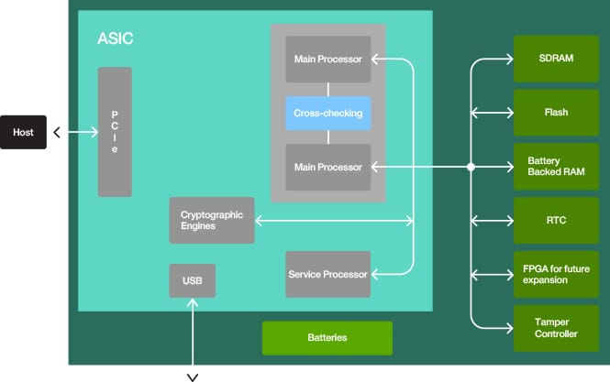
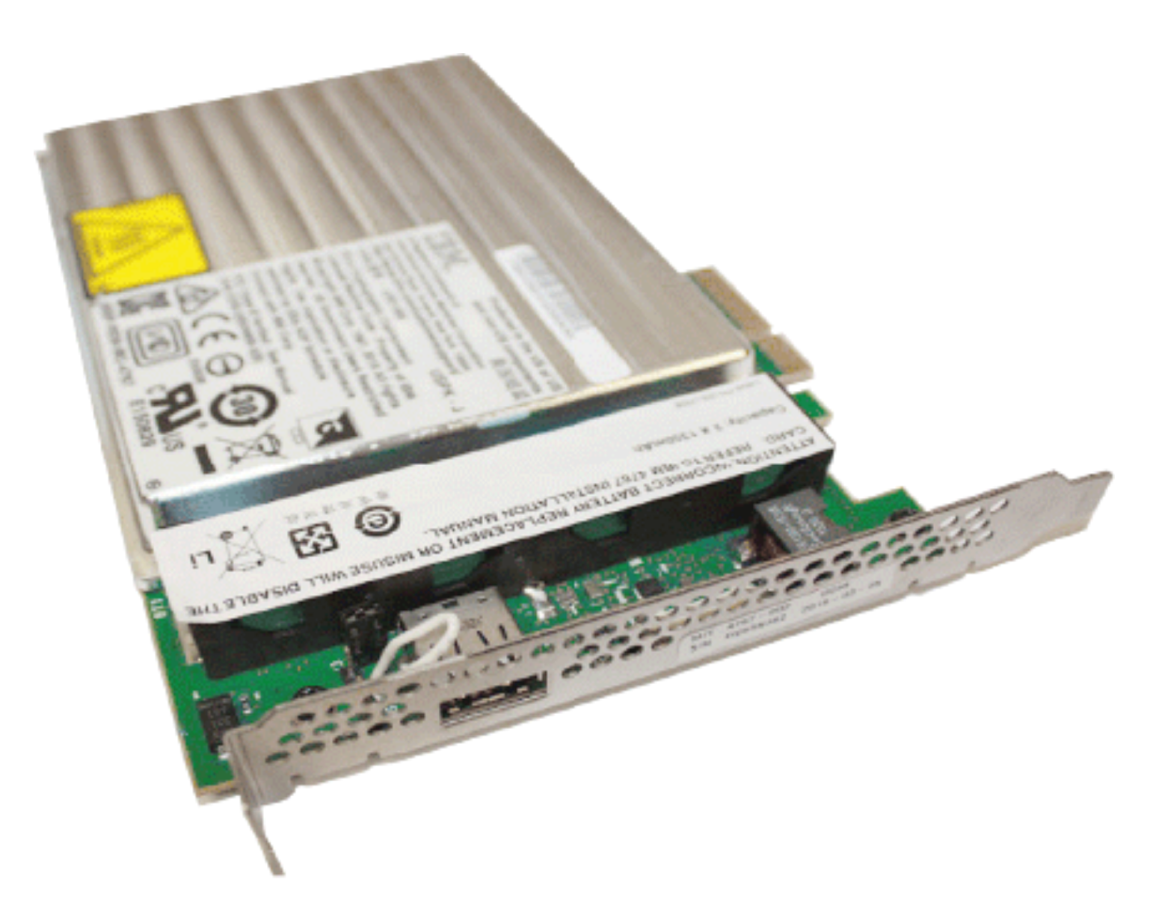
Key Management
CryptoCards
Hardware Security Module (HSMs)
Notes:
What is an HSM? An HSM is a Hardware Security Module, a general-purpose computing environment that withstands both physical and logical attacks and has special hardware to perform cryptographic operations and protect keys. The HSM is accessed from a host computer system using a carefully-designed set of API functions. The API functions may be generic, or they may be designed to meet the special requirements of particular industries such as banking and finance.
The device must run the programs that it is supposed to run, with confidence that those programs have not been modified. You must be able to (remotely) distinguish between the real device and application, and a clever impersonator.
The HSM must remain secure even if adversaries carry out destructive analysis of one or more devices. Many servers operate in distributed environments where it is difficult or impossible to provide complete physical security for sensitive processing. In some applications, the motivated adversary is the end user. You need a device that you can trust even though you cannot control its environment.
Hardware Security Module
BM cryptographic coprocessor family of PCle cards with a multi-chip embedded module is the IBM PCle Cryptographic Coprocessor Version 3 (PCleCC3). Its predecessors are the PCle Cryptographic Coprocessor Version 2 (PCleCC2) and IBM PCle Cryptographic Coprocessor Version 1 (PCleCC).

Slide 16
Air Gap Separation
EAL5+ Certification
Workload Isolation
Secure Enclaves
firmware virtualization of logical partitions (LPARs)
Notes:
Wor􏰂loads are also isolated on Linu􏰃ONE, using the firm- ware virtualization of logical partitions (LPARs). These ensure near air-gap separation between workloads and have enabled Linu􏰃ONE to be certified at
EAL5+, one of the highest commer-cially available certifications.

Slide 17

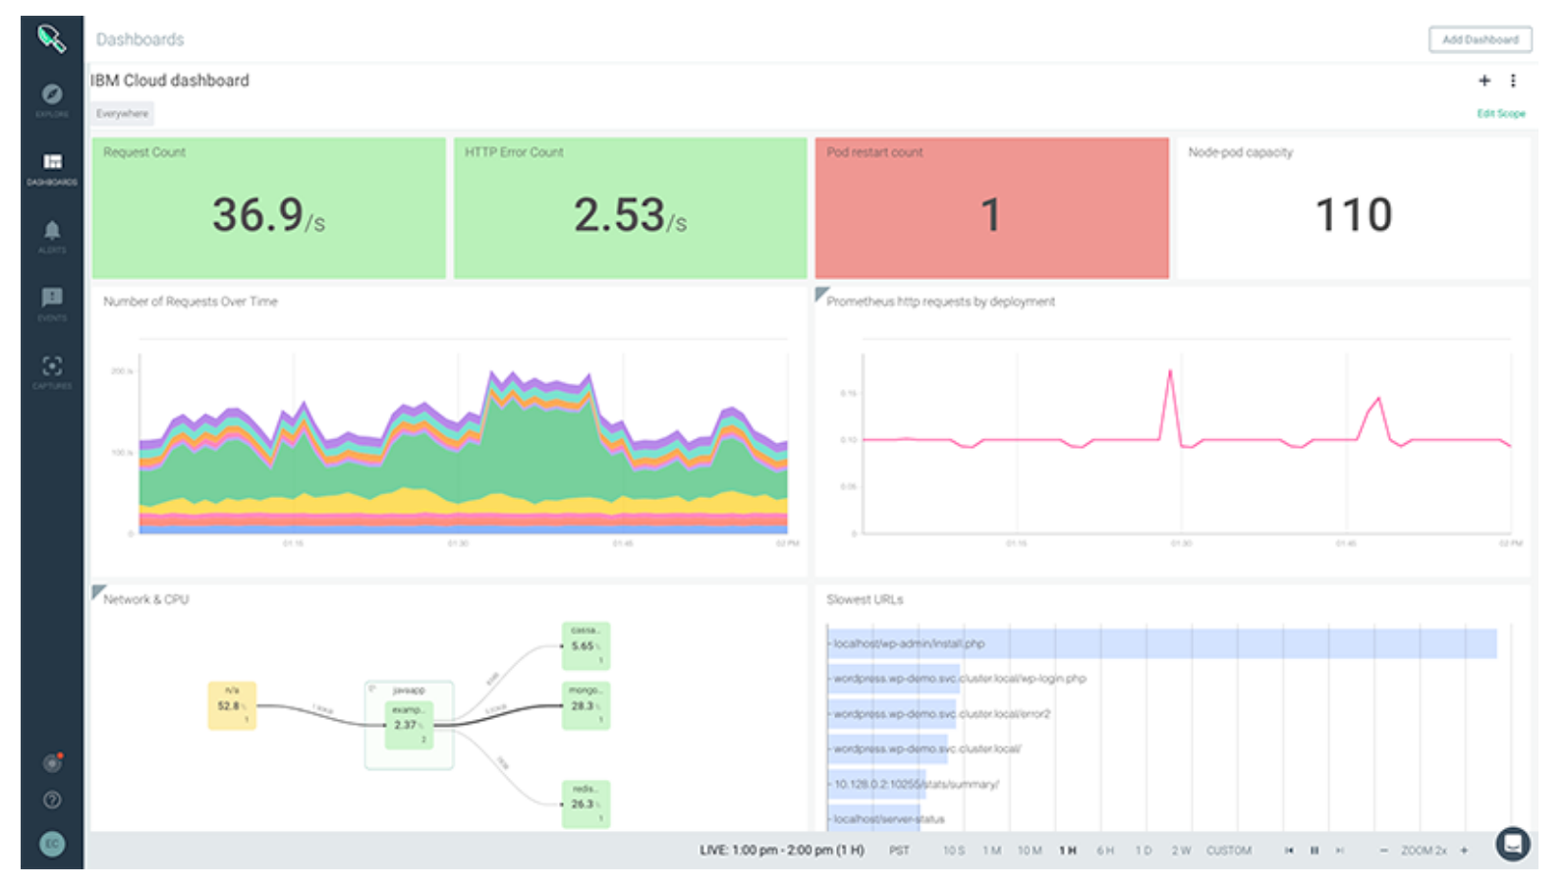
Isolated tenants – Calico
Kubernetes Cluster + Isolation befits of Mainframe hardware
IBM Secure Service Container
Takes workload isolation to next level!
IBM Cloud IKS + Sysdig alerts
Notes:
Building on logical partitions is the IBM Secure Service Container technology, which takes workload isolation to the next level by providing a secure computing environment for container-based applications.
Isolated tenant net􏰎 works leverage Calico (a network policy service for Kubernetes clusters) to improve performance and network isolation inside clusters.
Sysdig Get operational visibility into Kubernetes-based applications, services and platforms
To make these hardware solutions available to the blockchain software, the Go language used to implement the blockchain Hyperledger Fabric has been ported and optimized for use on LinuxONE hardware.

Slide 18
Go language is ported and optimized for LinuxONE to make these hardware solutions available for Hyperledger Fabric

Slide 19
Privacy
Channels
MSP/ Identity
Private Data
Compliance / Legal
Notes:
MSP Membership Provider
Membership Service Provider (MSP) comes into play — it identifies which Root CAs and Intermediate CAs are trusted to define the members of a trust domain, e.g., an organization, either by listing the identities of their members, or by identifying which CAs are authorized to issue valid identities for their members, or — as will usually be the case — through a combination of both.
The power of an MSP goes beyond simply listing who is a network participant or member of a channel. An MSP can identify specific roles an actor might play either within the scope of the organization the MSP represents (e.g., admins, or as members of a sub-organization group), and sets the basis for defining access privileges in the context of a network and channel (e.g., channel admins, readers, writers).

Slide 20
Private Data
Channels?
administrative overhead
portion of the data private
Private Data Collections
SideDB
A hash of that data, which is endorsed, ordered, and written to the ledgers of every peer on the channel.
Notes:
In cases where a group of organizations on a channel need to keep data private from other organizations on that channel, they have the option to create a new channel comprising just the organizations who need access to the data.
However, creating separate channels in each of these cases creates additional administrative overhead (maintaining chaincode versions, policies, MSPs, etc), and doesn’t allow for use cases in which you want all channel participants to see a transaction while keeping a portion of the data private.
The actual private data, sent peer-to-peer via gossip protocol to only the organization(s) authorized to see it. private state database on the peers of authorized organizations (sometimes called a “side” database, or “SideDB”),
The ordering service is not involved here and does not see the private data.
The hash serves as evidence of the transaction and is used for state validation and can be used for audit purposes.
Collection members may decide to share the private data with other parties if they get into a dispute or if they want to transfer the asset to a third party. The third party can then compute the hash of the private data and see if it matches the state on the channel ledger, proving that the state existed between the collection members at a certain point in time.

Slide 21
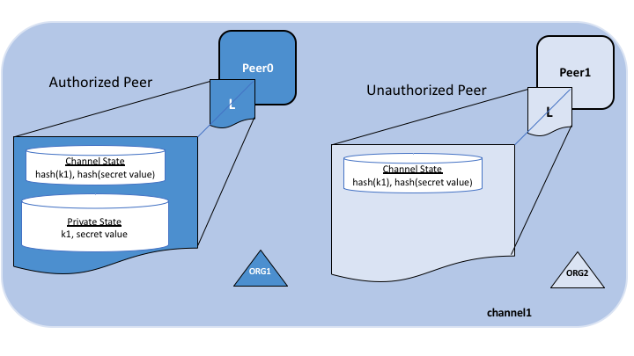
private data collection
Notes:
The following diagram illustrates the ledger contents of a peer authorized to have private data and one which is not.

Slide 22
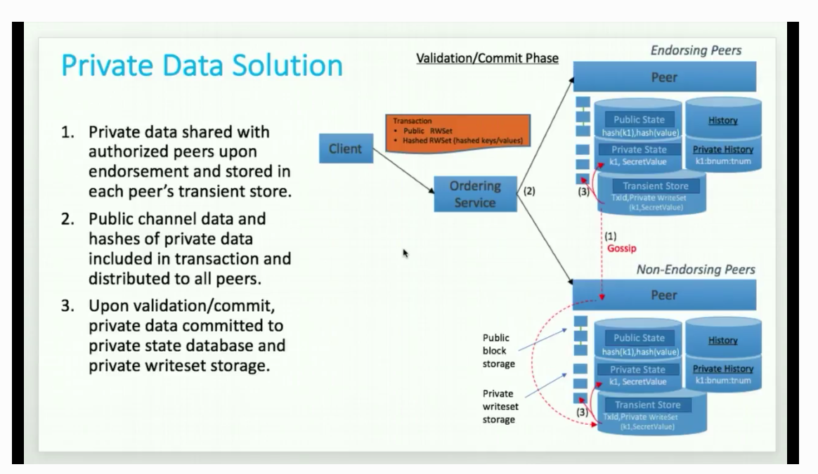
3 steps
Notes:
Off video

Slide 23
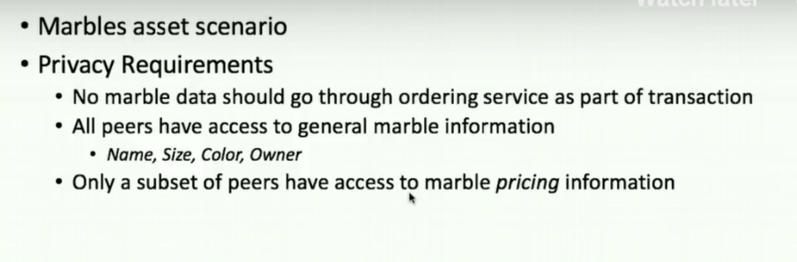
Private data – based of the infamous Marbles asset scenario
Notes:
Off video

Slide 24
Private data – based of the infamous Marbles asset scenario
Notes:
Off video

Slide 25
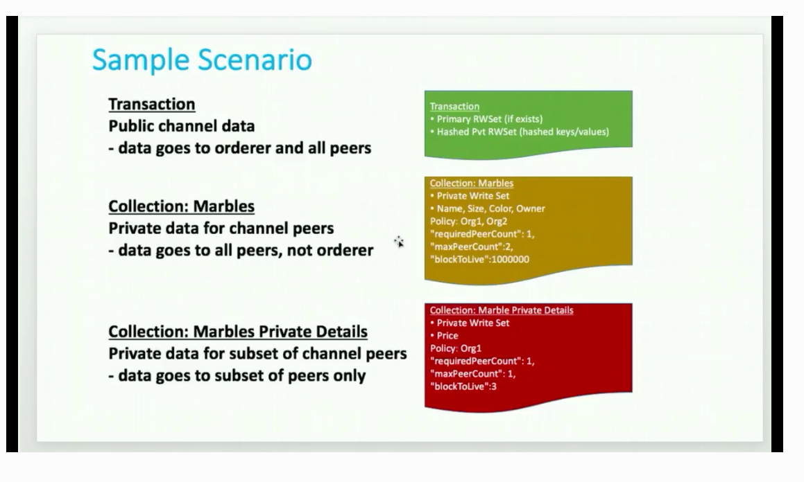
Private data – based of the infamous Marbles asset scenario
Notes:
If one peer offline it’s OK
Only Org 1 has access
Also
Block to live – even private data can expire ( super sensitive )
blockToLive: 3 – 3 blocks then purged ( 0 forever )

Slide 26
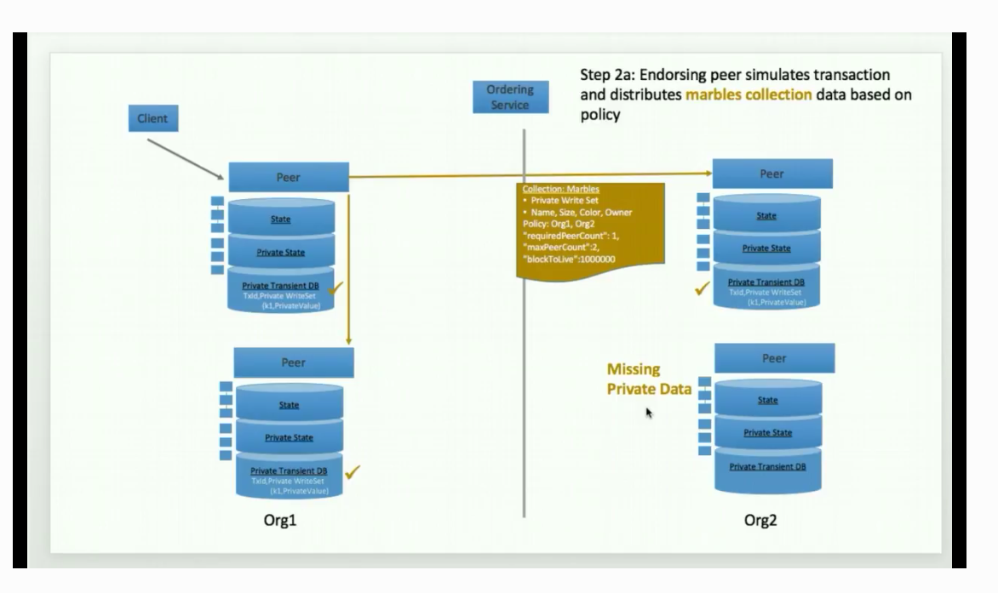
Private data – based of the infamous Marbles asset scenario
Notes:
If one peer offline it’s OK
Only Org 1 has access
Also
Block to live – even private data can expire ( super sensitive )
blockToLive: 3 – 3 blocks then purged ( 0 forever )

Slide 27
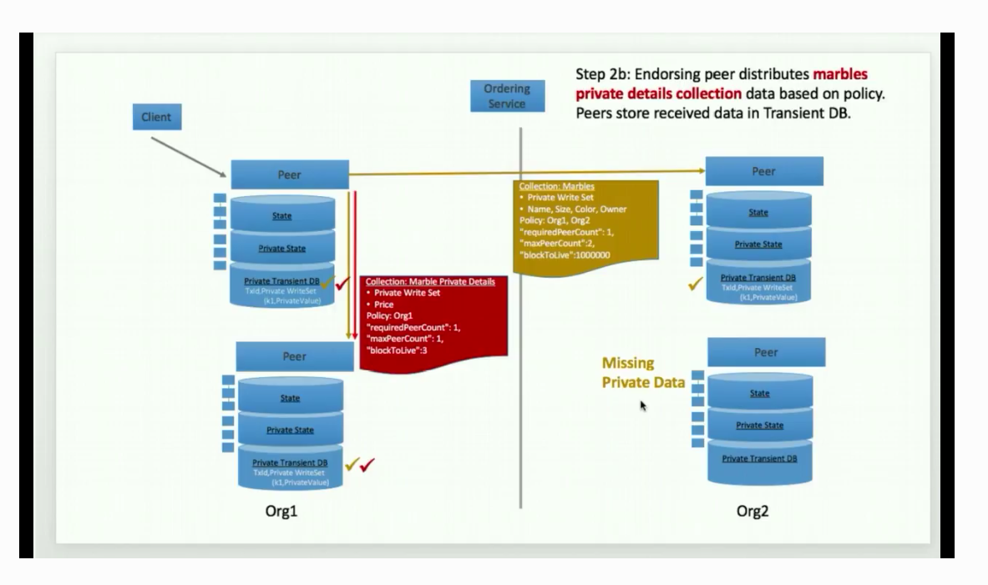
Private data – based of the infamous Marbles asset scenario
Notes:
Second collection with marble pricing info
Sent to 1 peer

Slide 28
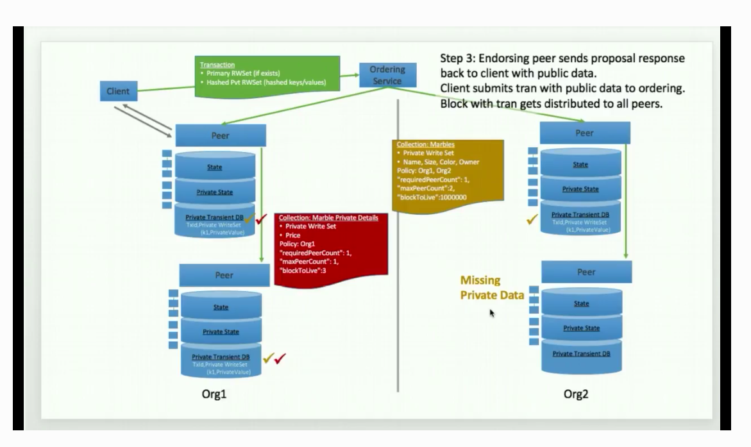
Private data – based of the infamous Marbles asset scenario
Notes:
Step 3
Endorsing peer sends proposal ….

Slide 29
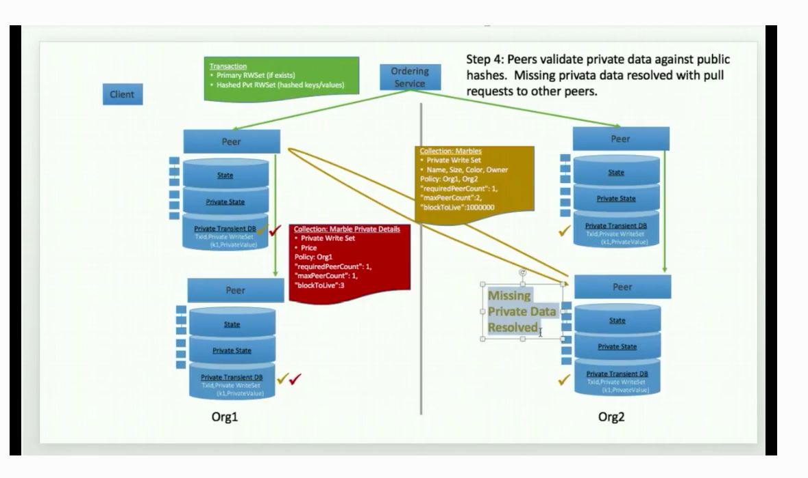
Private data – based of the infamous Marbles asset scenario
Notes:
Step
Missing private data

Slide 30
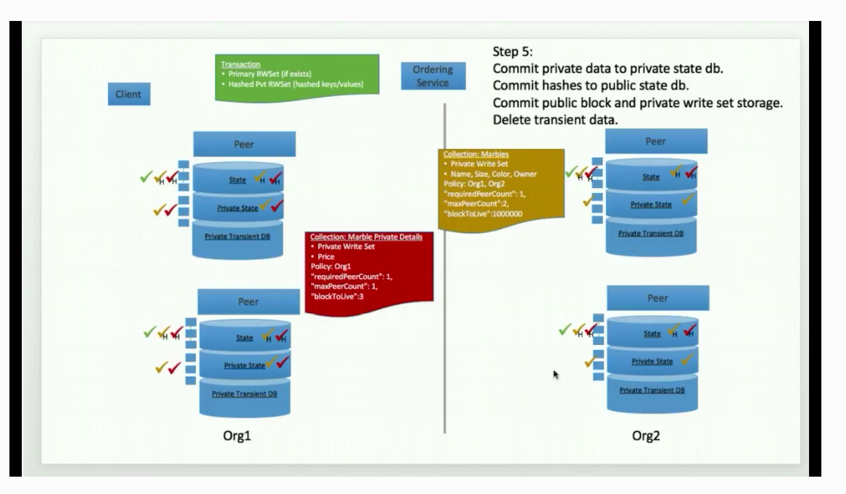
Private data – based of the infamous Marbles asset scenario
Notes:
Step 5

Slide 31

DEMO PRIVATE DATA
Notes:
Private Data HLF Tutorial Marble Data https://hyperledger-fabric.readthedocs.io/en/release-1.4/private_data_tutorial.html

Slide 32
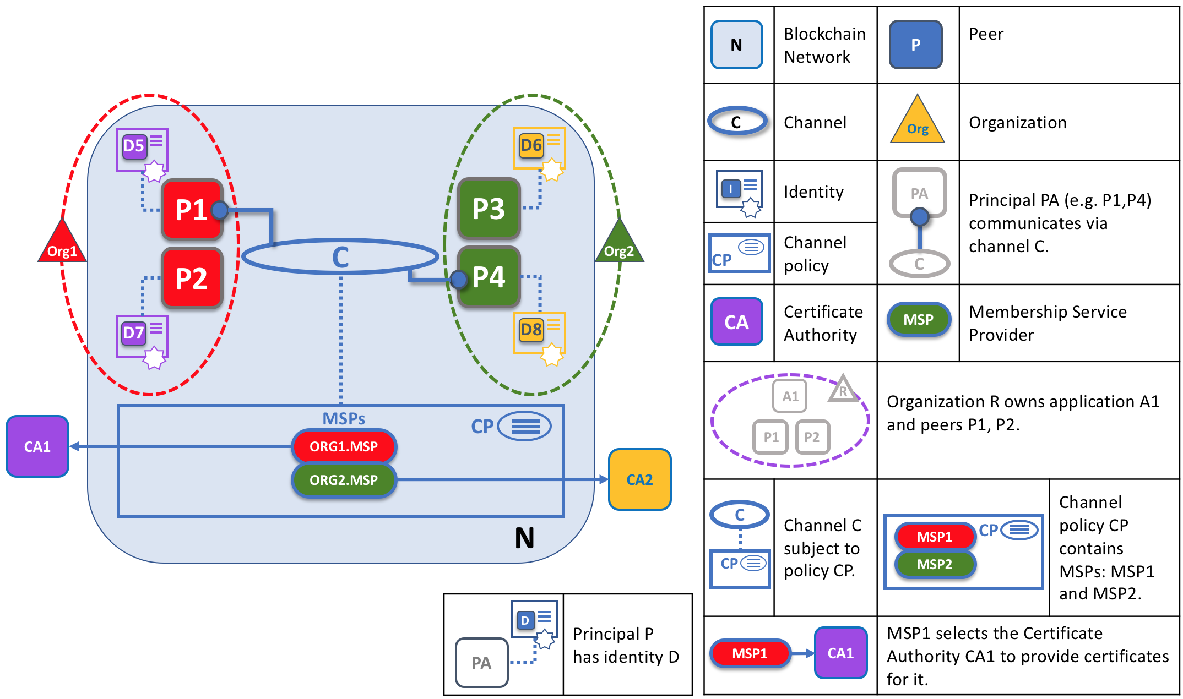
CA & MSP
Notes:
Each and every peer in the network is assigned a digital certificate by an administrator from its owning organization.
Whenever a peer connects using a channel to a blockchain network, a policy in the channel configuration uses the peer’s identity to determine its rights. The mapping of identity to organization is provided by a component called a Membership Service Provider (MSP) — it determines how a peer gets assigned to a specific role in a particular organization and accordingly gains appropriate access to blockchain resourceMSP as providing linkage between an individual identity and a particular organizational role in a blockchain network.

Slide 33
Summary
Anti-fragile - over time hardens + Open Source

Slide 34
Thank you
Join Call for Code
https://callforcode.org/
Faces of IBM
https://w3.ibm.com/w3publisher/faces-of-ibm/faces-of-pride
Future events:
Master Reactive Systems on IBM Cloud using Lagom Microservices [Hands-on]
https://www.meetup.com/ibmcodenyc/events/262583689/
Signup for IBM Cloud
https://ibm.biz/BdzzcG ( 06/24/2019 only!)
OR
https://cloud.ibm.com
Notes:
The winner of the first Call for Code Global Award received $200,000, open source project support from The Linux Foundation

Slide 35
Useful references
Private Data HLF Tutorial Marble Data https://hyperledger-fabric.readthedocs.io/en/release-1.4/private_data_tutorial.html IBM Code Pattern Medical Data using IBM Cloud IBPv2 https://developer.ibm.com/patterns/storing-private-data-off-chain-using-blockchain-think-healthcare-use-case
LinuxONE for dummies
https://www.ibm.com/downloads/cas/LBOVYYJJ
Hyperledger Fabric Security Audits
https://wiki.hyperledger.org/display/fabric/Audits
https://www.hyperledger.org/blog/2018/02/07/hyperledger-fabric-1-0-release-process

Slide 36


